Slide 1
Jan Ursi
February 2013

Slide 2


Business imperatives driving IT
Enhance agility
Improve security
Increase productivity
Notes:
Successful businesses (like for example Google, Amazon, Starbucks and Ebay) have found a way to get IT to be more Agile (quicker time to value, implement new projects faster), tighten security (virtual desktop infrastructure, neutralize BYOCloud) and increase productivity (predictable investment calculations, lower TCO, automate datacenter operations, pay as you grow).
However, many IT organizations still struggle to achieve these three goals. Why?

Slide 3

Nutanix believes in a happy IT experience
Beautiful integrated design
Best user experience
Intuitive to setup and use
Always-on

Slide 4
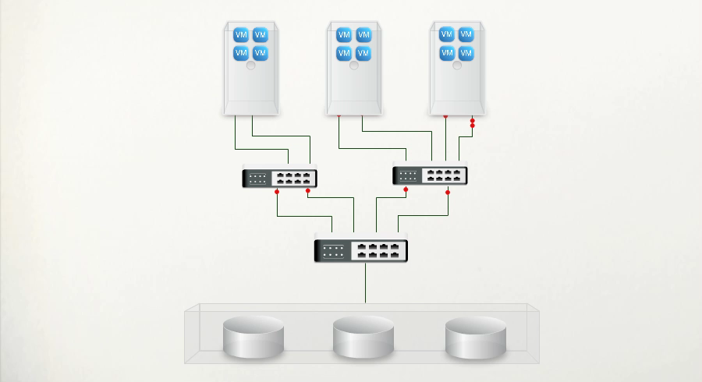
Problem: legacy datacenter architecture
Compute
SAN Network
Storage
Complex.
Rigid.
Manual.
Notes:
The problem is the legacy datacenter, which is designed in the 90’s and not ready for the proliferation of large number and changing nature of Virtual workloads that have variable i/o demands (eg. Virtual desktop vs virtual server).
The main problem is the 3 moving parts that needs to be installed, managed and maintained separately. Which is complex, rigid and needs constant manual reconfiguration.
SAN/NAS networks make storage an island and keeps the workload in the compute part “far away” from its data.
Legacy architecture is expensive to scale as it only scales up in large forklift upgrades. Every moving part tends to get over provisioned (unpredictable and high TCO).
Having 3 individual moving parts add complexity as it needs continuous manual fine tuning.
SWPPCCCSSS (courtesy of Dave Gwyn)
Consumes too much space
Becomes wiring nightmare
Consumes too much Power
Politics between admins of 3 moving parts inhibits speed of implementation
…
Application developers and business decision makers just want an easy infrastructure to run the applications, which can grow and shrink in small granular increments, and automagically provides the best user experience.

Slide 5
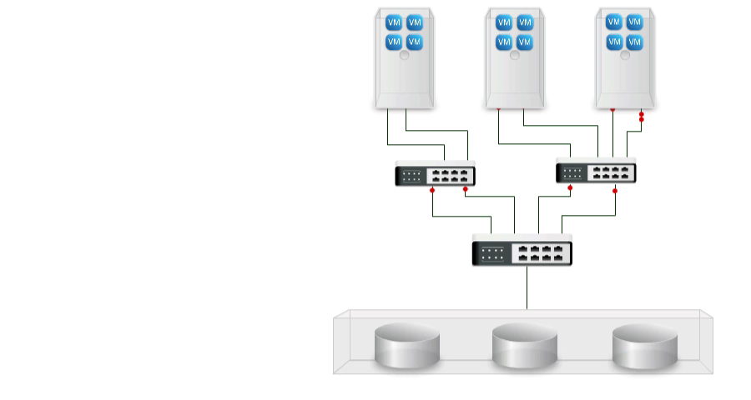
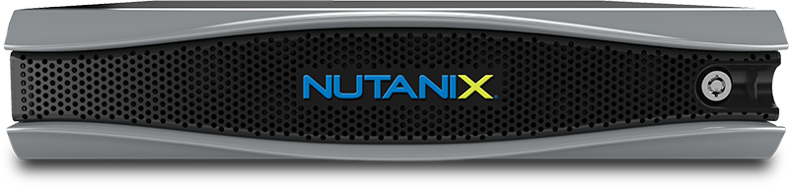
Solution: next-gen computing platform
Simple.
Scale-out.
Automagic.
Notes:
The only way to overcome these problems is to deploy a next generation data center architecture, just like successful businesses like Google, Amazon, eBay, Facebook did.
The bright minds that build the Data Center infrastructure for Google and Facebook built Nutanix, the next generation computing platform.
Converge compute, storage and network in one single computing platform which is:
-Easy: very easy to deploy, manage and maintain (integrated GUI to manage all)
-Scales-out: from one node to hundreds of nodes, scaling compute and storage linearly from small to massive.
-Automated: automatically provides the best possible end-user experience such as moving hot data in faster storage media, moving data closer to workloads, auto-optimize flash usage, etc.

Slide 6
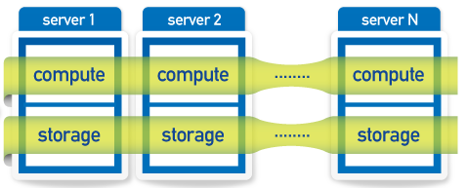

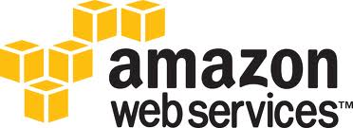

Embracing game changing innovation
Collapse compute, storage and network into a single node
Built with commodity, latest and greatest hardware
Running a unique distributed operating system
Compute and storage of each node available as one pool of resources
Automated performance optimization for virtualized workloads

Slide 7
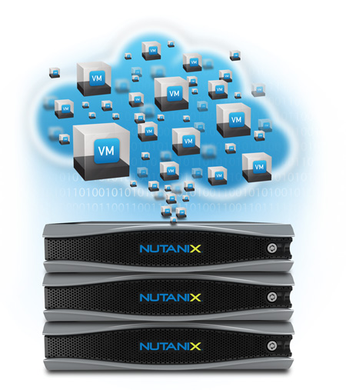
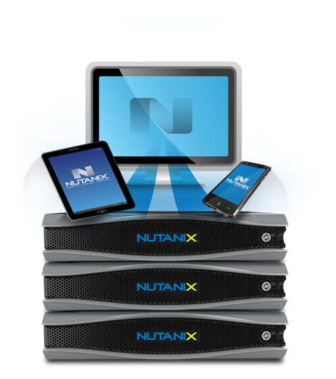
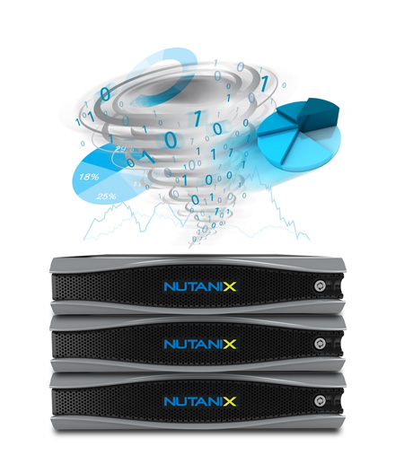
Versatile deployment cases
Server Virtualization
Desktop Virtualization
Big Data and DR
Private Cloud Initiatives
VMware View
Citrix XenDesktop
Hadoop / Splunk
Elastic DR

Slide 8
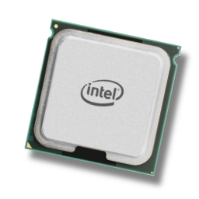
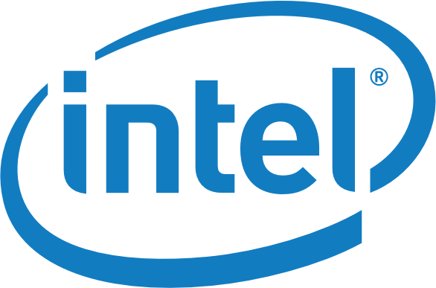
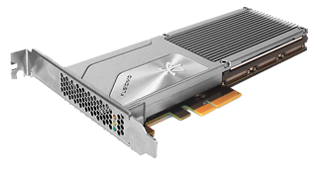

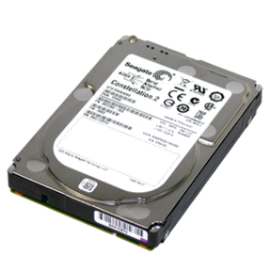

Beautiful integrated design
Dual Sandy Bridge 8-core CPUs
High-performance PCIe flash SSDs
High-capacity SATA HDD and SDD

Slide 9
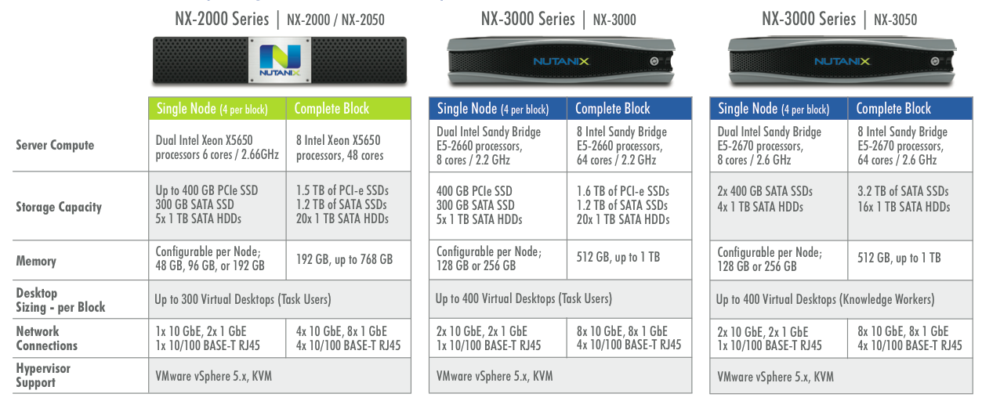
Hyper converged hardware

Slide 10
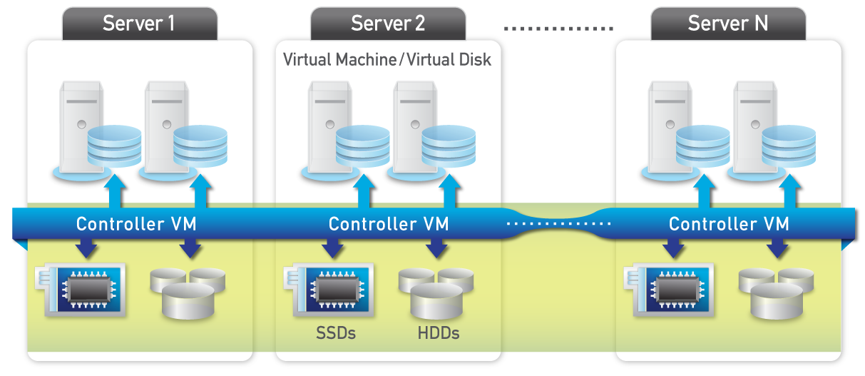
Pool all resources for best user experience
Notes:
Fully-distributed for massive scalability
Hypervisor agnostic for mixed workload environments
Storage pooled into a single datastore for all VMs
nController model ensures linearity at scale
Seamless cluster expansion with zero downtime
Advanced ILM – data localization and tiering for fastest performance
Full enterprise-class storage capabilities – clones, snapshots, replication

Slide 11
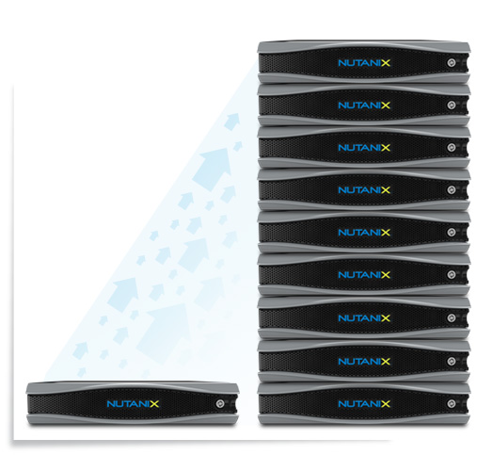
Pay-as-you-grow
Scale one node at a time
Much lower TCO by eliminating forklift upgrades
Scale compute and storage independently as needed

Slide 12
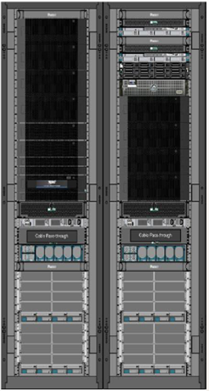


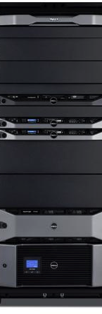
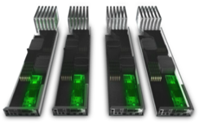
The next-generation of convergence
2x – 5x smaller datacenter
Unit of Growth =
Single Node
One block is 4 nodes
From three to hundreds of nodes
VCE’s vBlock 300
Cisco/NetApp
FlexPod
Dell’s vStart 50 “Baby” Cloud

Slide 13

Intuitive to setup and use
Deploys in less than 20 minutes, intuitive GUI and CLI
Built in Data tiering, cloning, snapshotting, compression, DR, etc.
Hypervisor preinstalled ready to run virtual workloads
In service upgrades and updates

Slide 14
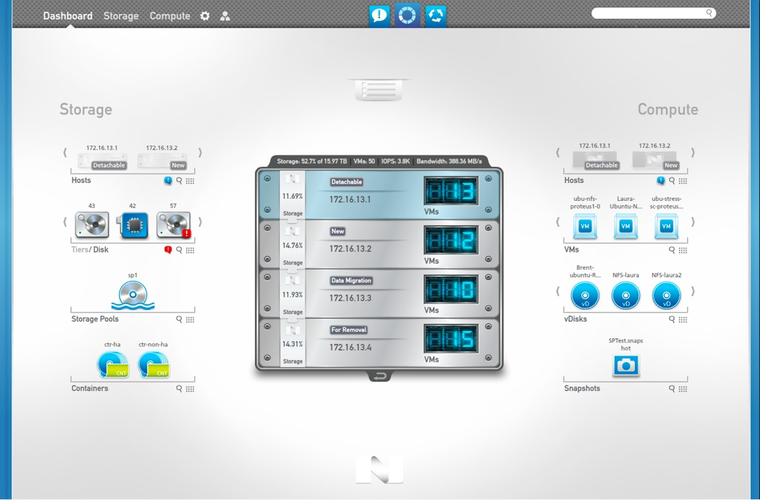
Storage & Compute, in one GUI

Slide 15




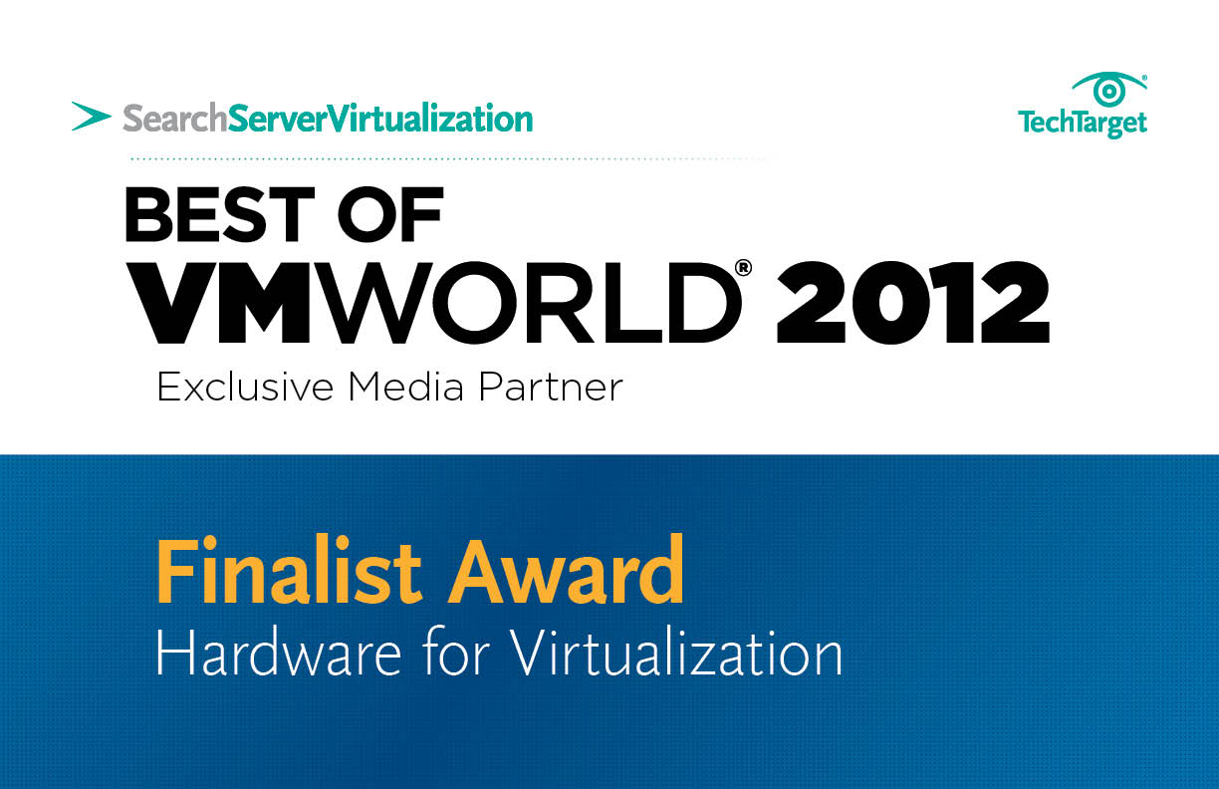




Broad industry recognition
Top 10 Storage Startups
Top 50 Cloud Innovators
“ I am always hesitant to declare a product a "game changer" but Nutanix may have
just done that with their Nutanix Complete Cluster.”
George Crump, Founding Analyst
“ In the case of EMC, HP or NetApp, they're taking the same storage products they've been selling for years and repackaging for virtual server environments. I think Nutanix's product is a powerful solution. It's a powerful architecture concept.”
Andrew Reichman, Senior Analyst
“ Did Nutanix just create the ultimate server/storage big data combo hardware for VDI?”
Brian Madden, Independent Desktop Virtualization Expert
“ If workable in real-time, that would mean Nutanix has one-upped competitors like EMC Corporation, Cisco Systems, NetApp, VMware and Hewlett-Packard”
Riley McDermid of VentureBeat

Slide 16












Rapid customer adoption

Slide 17




Built for long-term success
Fastest adopted infrastructure solution ever
$72M raised in 3 rounds of funding – incorporated in 2009
Core team from Google, Oracle (Exadata), Aster Data, VMWare, Palo Alto Networks, Data Domain, NetApp and Cisco
Software-driven platform, built with latest best in class commodity hardware
100% channel-fulfilled distribution model
Widely recognized as innovative and disruptive

Slide 18

Summary
Business drives datacenter transformation
A new architectural approach is required
Nutanix – The next-gen computing platform
Simple, Scale- Out, Automagic
Happy IT experience
Notes:
Anything we can do special for a summary slide – instead of just bullets?

Slide 19

Thank You
NUTANIX INC. – CONFIDENTIAL AND PROPRIETARY

